Slide 1
The Future of Transport: quickER
Daniel Toh, Mario Tanijaya, Matthew Kan
from Team Optimus Prime

Slide 2
quickER helps patients plan their trip to emergency rooms to receive treatment quickER.

Slide 3
Problem
The Emergency Rooms (ER) of the public hospitals in Singapore are very busy.
The waiting time to see a doctor in the ER can range from 0 mins to 8 hours.
According to the Ministry of Health, waiting times are a major source of complaint and dissatisfaction was highest in the ER.

Slide 4
Problem
Ageing population
More elderly in the future
Vulnerable to illnesses and accidents
Longer waiting times
Better planning needed to facilitate faster treatment times for everyone

Slide 5
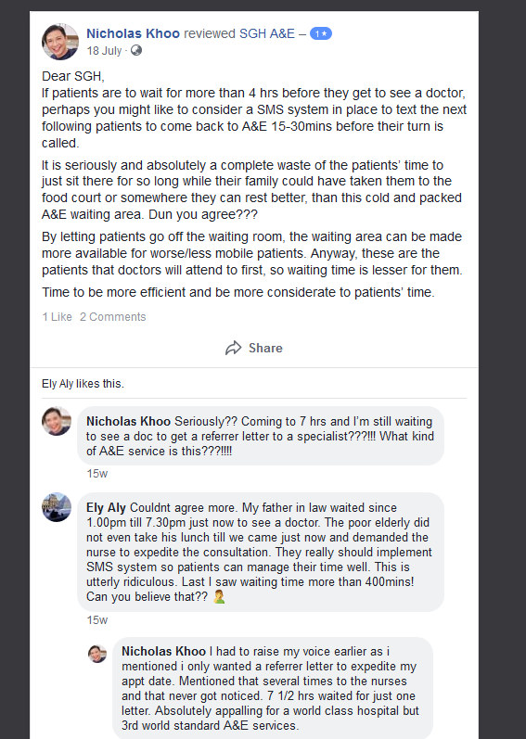
Patients complain on FB about long waiting times of >7 hours to see a doctor in ER

Slide 6
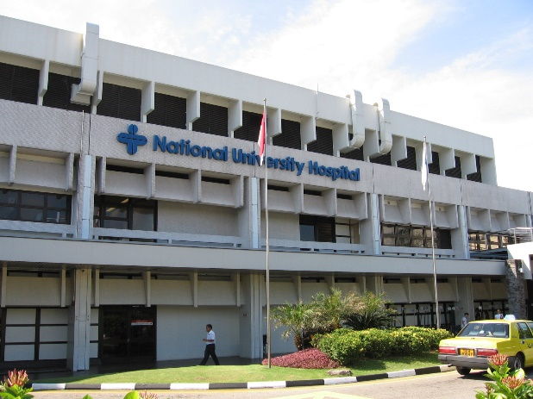
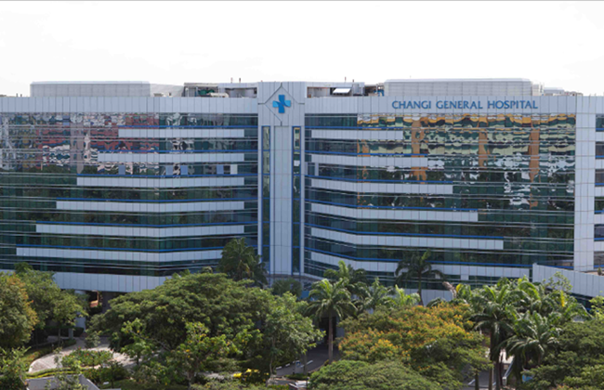
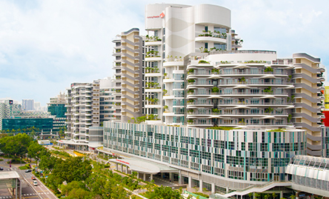
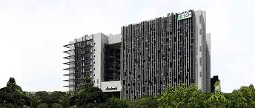
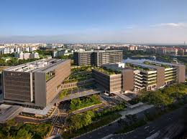
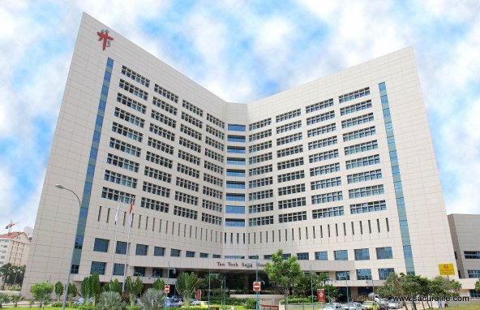
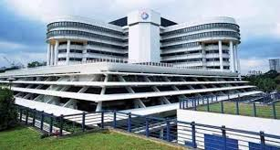
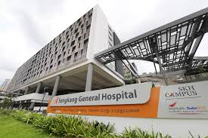
9 Public Hospitals in Singapore
Woodlands Hospital (currently under construction)
National University Hospital (NUH)
Changi General Hospital (CGH)
Ng Teng Fong Hospital (NTFH)
Singapore General Hospital (SGH)
Khoo Teck Puat Hospital (KTPH)
KK Women’s and Children’s Hospital (KKH)
Sengkang General Hospital (SKGH)
Tan Tock Seng Hospital (TTSH)

Slide 7
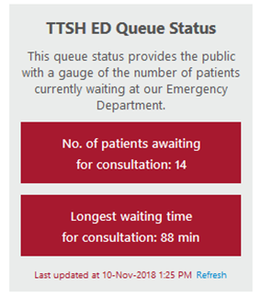
Current Situation
Only Tan Tock Seng Hospital displays its ER waiting time on its website in real time (https://www.ttsh.com.sg/emergency/#queue)
Ng Teng Fong Hospital has a video image of his waiting area as a visual gauge of the number of patients waiting (https://www.ntfgh.com.sg/Patients_and_Visitors/Emergency_Department_Queue_Viewer.aspx)
KTPH, SGH and SKH have a queue viewer on their websites but the queue viewer is not working.
CGH, KKH and NUH do not have a queue viewer.

Slide 8
Aim of quickER
Display the waiting times for all the ERs in all the public hospitals
Compute the travelling time to all the ERs from the patient’s location
Calculate and display the total time required
Help the patient to make an informed decision about which ER to seek treatment at

Slide 9
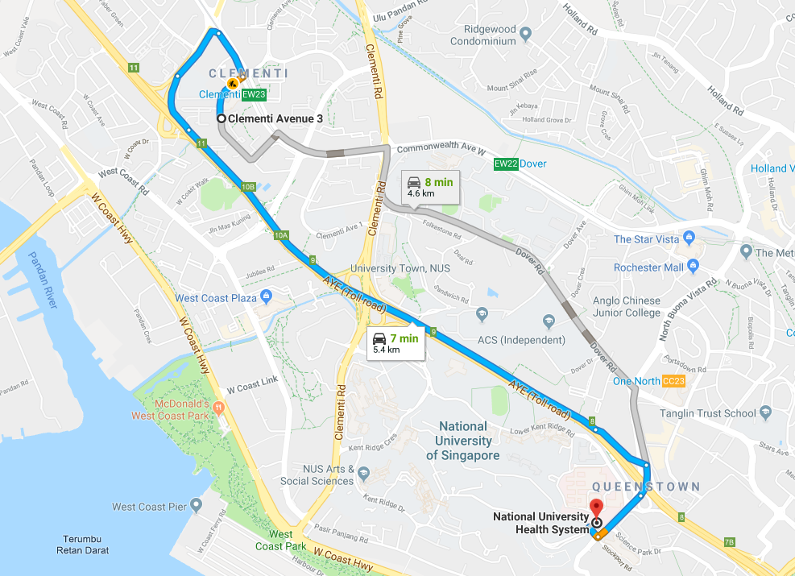
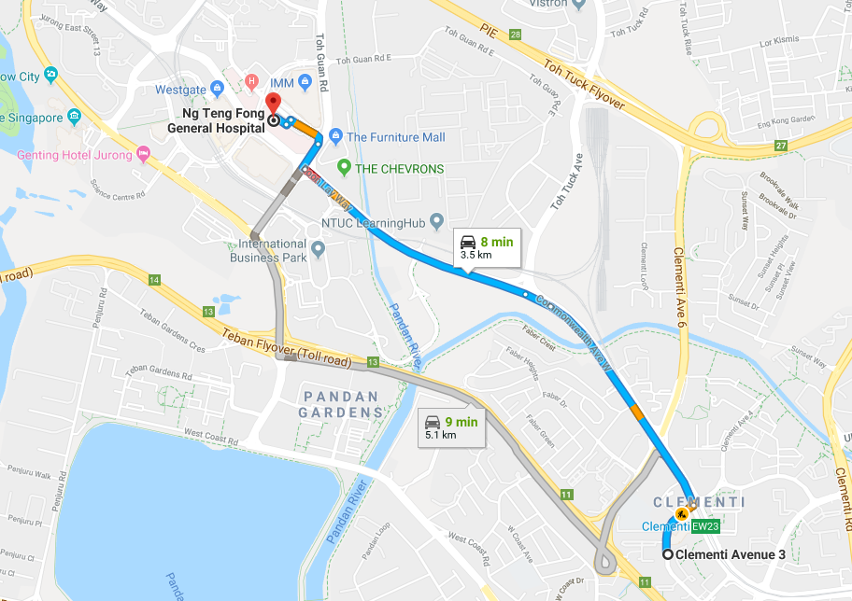
Example
Patient lives in Clementi
Nearest 2 ERs are NUH and NTFH
Waiting Time in NUH is 45 minutes
Driving Time to NUH is 7 minutes
Total Time is 52 minutes
Waiting Time in NTFH is 30 mins
Driving Time to NTFH is 8 minutes
Total Time is 38 minutes
Patient chooses to go to NTFH for treatment

Slide 10
How quickER works
Simulated waiting times that change based on time
Travelling times calculated with geometry with latitude and longitude
Displays the sum of times and suggests the hospitals that can treat the patient the quickest.
Also links to google maps for directions to the hospital.

Slide 11
Demo of quickER algorithm in C++
The latitude and longitude of IDEAS hub is ~(1.30239,103.77783)

Slide 12
Potential App Design

Slide 13
Future Work / Improvements
Obtain real time ER waiting times for all the public hospitals instead of simulated data
Incorporate Google Maps for calculating travelling time
Will factor in traffic conditions
Making the app
Using the same idea for other facilities (e.g restaurants)
Connecting the app to transport services such as Grab

Slide 14
Thank you

